Slide 1

The 6 –th INTERNATIONAL MULTIDISCIPLINARY CONFERENCE
SCIENTIFIC CHALLENGES FOR SUSTAINABLE DEVELOPMENT
UNIVERSITY OF VLORA «ISMAIL QEMALI»
Erasmus Plus - MARDS Project
Grant: 598465-EPP-1-2018-1-ME-EPPKA2-CBHE-SP”

Slide 2
UNIVERSITY of VLORA operating since 1994
Currently are 4 faculties:
  Faculty of Economy
  Faculty of Technical Sciences
  Faculty of Human Sciences
  Faculty of Public Health
Students number for 2018-19 accademic year:
  3971 students at Bachelor study program
  1298 students at Professional Master
  502 students at Master of Science
  12 students at PHD

Slide 3
PEDAGOGUES:
The accademic staff is currently composed of:
  5 Full Professors
  27 Associated Professors
  95 PHD/Doctors
  81 MSc

Slide 4
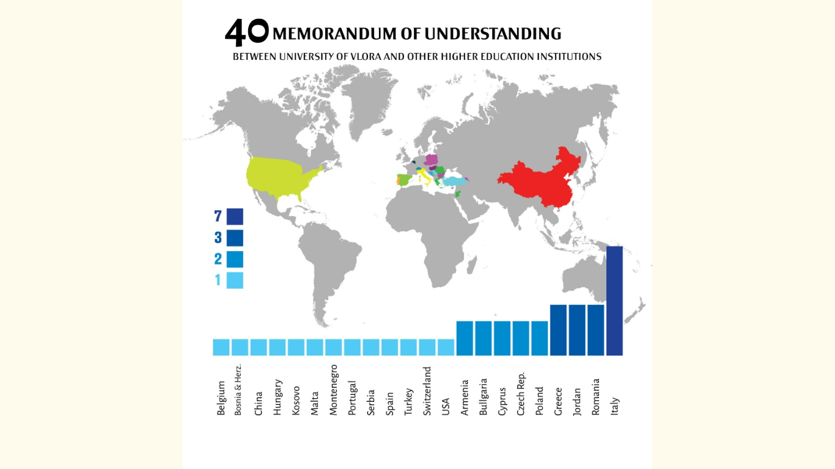

Slide 5
ROLE AND MISSION
Contemporary teaching;
High quality of basic research, applied and academic work;
Effective and impacting services in the public and community;
Comprehensive programs of student development activities;
Lifelong learning.
Offering programs:
Bachelor – 27 study programs
Master of Science and Professional Master – 31 study programs
PhD – 1 study program in Mathematics

Slide 6
MARDS Partners
P1: University of Montenegro – UoM, Montenegro
P2: University of Vienna – UNIVIE, Austria
P3: University of Maribor – UM , Slovenia
P4: Faculty of Education and Rehabilitation Sciences (ERF) University of Zagreb (UNIZG), Croatia
P5: Matej Bel university – UMB, Slovakia
P6: University of Donja Gorica – UDG, Montenegro
P7: University of Shkodra „Luigj Gurakuqi“ – UNISHK, Albania
P8: Polytechnic University of Tirana – PUT, Albania
P9: University of Vlora – UV, Albania
P10: Metropolitan University of Tirana – UMT, Albania
P11: Ministry of Education of Montenegro – MoE
P12: Ministry of Science of Montenegro – MOSM
P13: Ministry of Education, Sports and Youth of Albania – MESY
P14: Chamber of Economy of Montenegro – CEM
P15: Association for professionals in doctoral education – PRIDE, Austria
P16: Union of Chambers of Commerce and Industry of Albania – UCCIAL

Slide 7
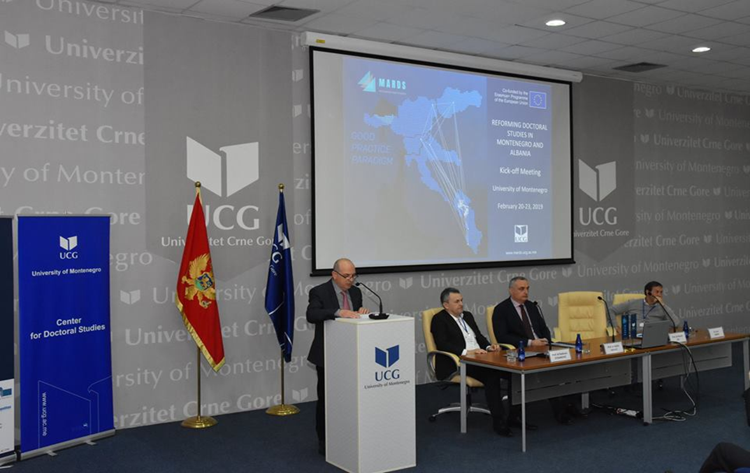
KICK-OFF MEETING, Podgorica Montenegro, 21-22 Feb 2019

Slide 8
MARDS Project aim
The main aim of the project:
to reconstruct doctoral studies in line with Salzburg Principles,
establish sustainable funding mechanisms in this area and
introducing two modern Pilot Joint Doctoral Schools between two friendly neighbours countries, Albania and Montenegro, that will serve as an example of good practice for the WB Region.

Slide 9
Key Objectives of MARDS Project
To monitore and analyze of national systems and policies of doctoral education in Montenegro and Albania and to compare with EU practices
to develop and propose a new model of doctoral studies in two countries, adapted to the acquired experiences over past decades and current and future countries’ needs
to propose a sustainable method of financing doctoral studies in two countries on national levels.
to establish two Joint Doctoral Schools "Natural sciences and Technology for Sustainable Development" with place in Montenegro (Podgorica) and “Economy and Tourism for Sustainable Development” with place in Albania (Shkoder) as the recommendable examples of cross-border PhD programmes
to establish a sustainable cooperation with EU partners and established Doctoral School in order to maintain developed standards.

Slide 10
WHAT HAS BEEN DONE TILL NOW (THE DELIVERABLES)
A1.1 "Evaluation of the existing doctoral education policy and standards in Montenegro and Albania and comparing with EU practices”
The legal framework of doctoral educations in Albania is regulated by:
the Albanian Law for Higher Education and Research, 80/2015 dated 22.07.2015,
by sub laws and especially with sub-law number 112, date 23.2.2018c Determining The Criteria For The Award Of Scientific Grade "Doctor"
State Standards For The Benefit Of The Titles "Associated Professor" And "Full Professor”
Albanian Agency for Research (AKKSHI) approves, on the basis of free competition among applicants, funds for doctoral studies.
PhD studies are built on individual programs for independent research in the fields defined by the department/unit or the Faculty.
PhD studies last no less than 3 academic years and no more than 5 academic years.

Slide 11
WHAT HAS BEEN DONE TILL NOW (THE DELIVERABLES)
UV has an active New Statute → UV Regulation → a dedicated board for doctoral studies at Faculty of Technical Sciences
UV offers doctoral studies in the field of Maths only
 | 2014 | 2015 | 2016 | 2017 | 2018
Numbers of totally enrolled doctoral candidates in the last 5 years | 20 | 12 | 11 | 11 | 9
Numbers of yearly new enrolled doctoral candidates in the last 5 years | 0 | 0 | 0 | 0 | 0
Numbers of degrees awarded in the last 5 years | 0 | 1 | 1 | 0 | 2

Slide 12
A 3.1. Evaluation of models of funding doctoral studies in Montenegro and Albania
Which are the main sources for institutions to finance doctoral education?
According to the law, NASRI approves, on the basis of free competition among applicants, funds for PhD studies.
Research Centres can provide also funds for doctoral studies
Another possibility for funding are other public or private institutions
another chance for doctoral grants/scholarships are the budget of the Universities

Slide 13
Future/next steps for MARDS Project
MARDS Confernce in Kotor, Montenegro
MARDS Training in Vienna on „Professional Management of Doctoral Studies
Training of Professionals in Doctoral Education: The aim would be to achieve a balanced group of participants between scientific and administrative staff.
A4.1 Development of curricula for Joint doctoral schools
A4.2 Equipping the laboratories and other infrastructure at partner universities
A4.3 Accreditation of the Doctoral schools
A4.4 Enrolling the first generation
A4.5 Programme implementation

Slide 14
Project outcome for University of Vlora
Knowing better local and country situation;
Comparing situation with EU countries;
Training of our staff in doctoral education → could serve as train the trainer;
Guidelines and recommendations for our staff;
Development of a new funding method;
New curricula for Joint PhD programme;
Equipment;
Increase research capacity of University of Vlora;
UV will be able to offer new study programs.

Slide 15

MARDS Project: https://www.mards.ucg.ac.me//
Thanks for your attention !!

