Slide 1

MARDS, NEO Monitoring Visit #3
Overview by
Prof. dr Radovan Stojanovic
University of Montenegro

Slide 2
Agenda
Overview of the Coordinator Prof. dr Radovan Stojanovic.
Overview of the Coordinating institution, Vladan Perazic
Partner UDG, report on activities
Partner “Privredna komora”, report on activities
Partner, bivše Ministarstvo nauke, report on activities
Partner, bivše Ministarstvo prosvjete, report on activities
The representative of the interested future students
Actual problems, COVID, operational and financial
NEO observations, recommendations and opinions
Discussion

Slide 3
Instead introduction
General project progress and workflow is given and illustrated at:
https://www.mards.ucg.ac.me/workflow.html
Overview in this presentation is for period from June 2020 – Feb 2021
The level of the realized activities Marking
good
partially done
critical

Slide 4
Content
Instead introduction?
Where we are?
Main problems and Mitigation ?
My and your our opinions?

Slide 5
Where we are at M29?
By Activities. See Workflow
All activities by workflow are done
https://www.mards.ucg.ac.me//workflow.html#O37
By deliverables
See the work plan for all 3 years!!!
In excel or in image
Done
Done
Partially done
In delay or critical

Slide 6
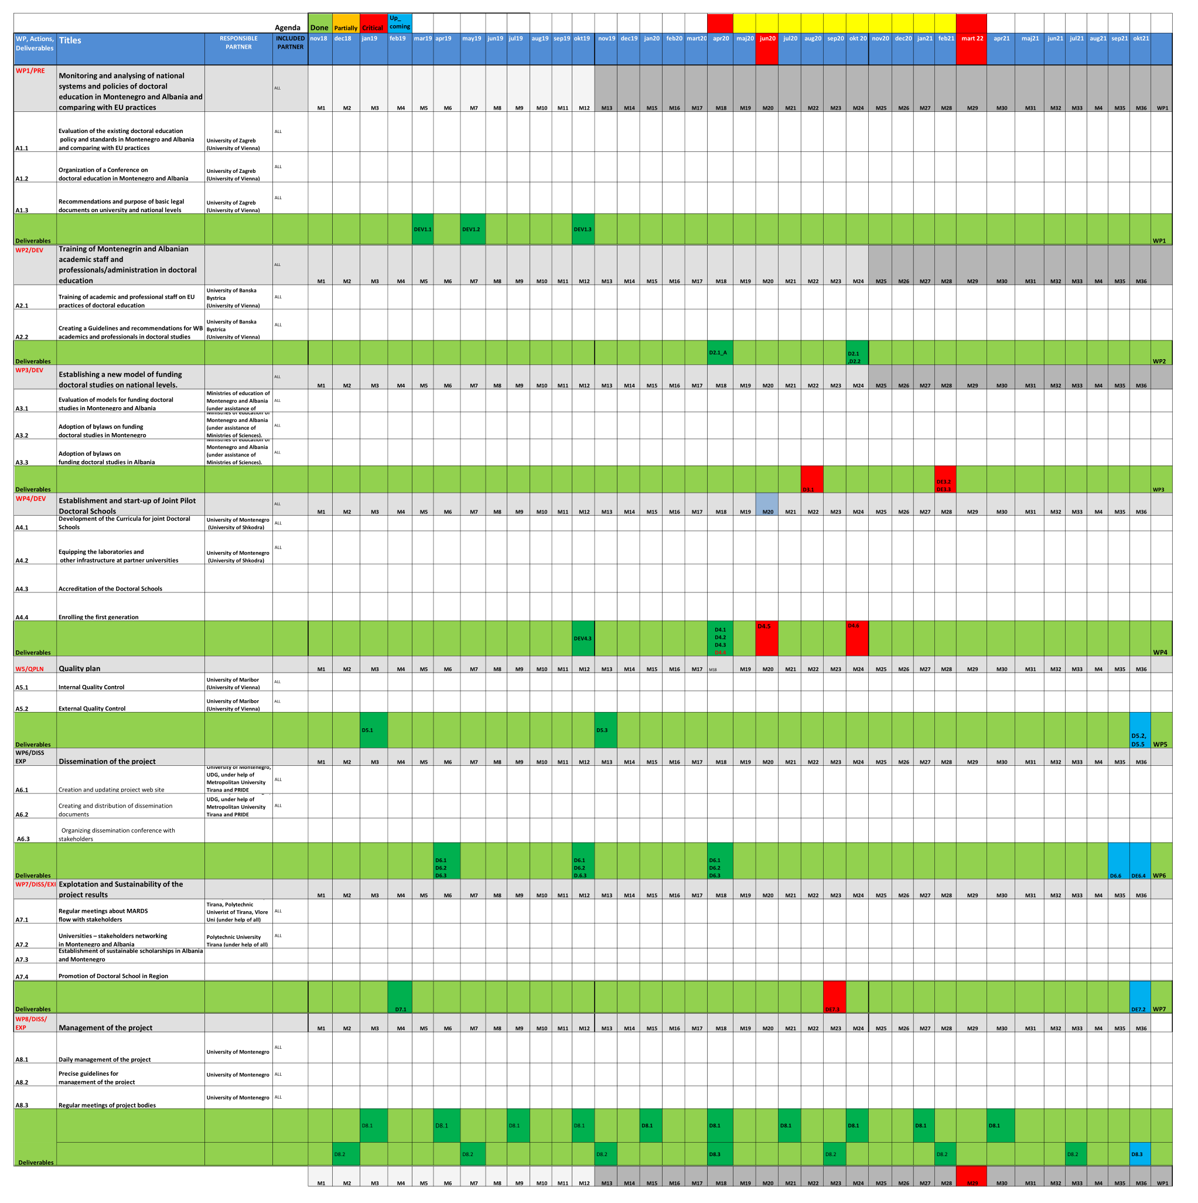
We
are
here!

Slide 7
Where we are by M29?
D2.1_A, Info on academic and professional training of WB staff/professionals/administrative' at EU“, Report, M18, UMB
D2.1,D2.2, D2.1 Report on academic and professional training of WB staff/professionals/administrative' at EU
D2.2 Guidelines and recommendations for WB academics and professionals in doctoral studies, Report, M24
D3.1, Report on appropriate funding doctoral studies in Montenegro and Albania,M22, Ministries in Albania and Montenegro,
D3.2D3.3, M28, Obligatory decision on adopting MARDS's methodology on funding for Montenegro and Albania, Misistries of Albania and Montenegro
Done
Done
Done
Delay 7 Moths
Delay 7 Moths

Slide 8
Where we are by M29?
DE4.4 Final version of accreditation application Report, M18 "University Shkoder and University of Montenegro other Albanian Unis
D4.5: Decisions on Accreditation, M20, Ministries in Albania and Montenegro
D4.6: The list of the enrolled students, M24, Podgorica, Shkoder
D7.3: Doctoral Scholarships provided, M23 Metropolitan University Tirana (under help of UoM)
DE8.1 Overall project management All outputs "M1-M36 Every 3 months will be checked deliverables, M1-M36, UoM
D8.2 Project coordination meetings, M1-M36, UoM
DE8.3 Periodical report. MID TERM. M18, UoM
Done
Delay 9 Moth!
Podgorica, partially
Shkoder, no info
Delay 6 Moths!
Done
Done
Done

Slide 9
Main problems and mitigation
Problem
Mitigation
D3.1, Report on appropriate funding, delay 6 months
Ministries in Montenegro and in Albania with helps with Universities in Albania and Montenegro in next month to finish Reports, responsible Jelena Šaranović, Marko Vukasinovic, Montenegro, Ingrid Jushi (Albania)
D3.2D3.3, M28, Obligatory decision on adopting MARDS's methodology on funding for Montenegro and Albania, delay 7 months
Senates/Upravni odbor of UoM and Ushkoder decision about free of fees for first generation of the students responsible (Predrag Miranovic, Arjeta Troshani) in next 3 months
D4.5: Decisions on Accreditation for Albania and Montenegro, delay 9 months
Application submitted to AKOKVO in next 2 weeks and AKOKVO Taking decision in before May 2021. For Albania they should to have decision. Responsible Mladen Prazic, Radovan Stojanovic, Sanja Pekovic.
D7.3: Doctoral Scholarships provided, delay 6 months
Till July 2021 do have decisions from Ministries Universities and other Institutions about Scholarships, Predrag Miranovic, Biljana Scepanovic, Rektor, Nedjeljko Latinovic

Slide 10
Main problems and mitigation
Problem
Mitigation
Paying to partners
Till end of the March 2021, Audit to finish job or to cancel agreement, Responsible, Vladan, Nikola, Vesna Rasovic
Paying to external experts
Till June 2021, after approval of firs QR from Matjaz Debevc
Paying to others (translators, subcontracting etc)
Radovan Stojanovic, Vesna Rasovic, Vladav Perazic
Subscription (upis) (translators, subcontracting etc)
Predrag Miranovic and Nedjeljko Latinovic
Helping Albanian partner
Radovan Stojanovic, Arjeta, Betim

Slide 11
Main problems and mitigation?
Problem
Mitigation
Management activities
Radovan Stojanovic, Mladen Perazic, Ana Trninic
Dissemination activities, saradnja sa privredom
Nikolina Radulovic, Mladen Tanja, Sandra, Albanian side
Doctoral colloquium
Biljana Scepanovic
Lessons and implementation for 1st year
Centre for Doctoral Studies

Slide 12
My opinion (recommendations)
Covid 19 problem partialy damaged project. University of Montenegro delayed activities, sometimes without any rationale reason. Albanian side do not follow EU agenda and Erasmus Rules.
Priorities of priorities
Request for extension (rector, coordinator, int office), next 15 days
Info about changing partners (rectors, coordinators, changed partners, int office), next 15 days
Application for accreditation to to AKOKVO (Rector, Pekovic, Miranovic, administrator), next 15 days
Info on subjects (as example names of the professors PMF, Miranovic), next 15 days
Status of the further students in term of payments (scholarships) (Rector, Upravni odbor, Miranovic, Ministries), next 2 months
Organization of the lesson process (Centre for doctoral studies), next 3 months
Problem of Albanian Accreditation Remain and it is necessary to help them even by merginig-joining, (Stojanovic, Tinaj, Vladan, Betim, Arjeta), next 1 months
Above follows R. Stojanovic and M. Perazic and local coordinators

Slide 13
Yours opinions (recommendations)
Opinions?
Recommendations?
Discussion?
Maybe at the end of meeting?

