Slide 1
Process of developing transversal competences at Matej Bel University
Related to project: THE ACCELERATION METHOD OF DEVELOPMENT OF TRANSVERSAL COMPETENCES IN STUDENTS’ PRACTICAL TRAINING PROCESS
Kamila Borseková
Contact: kamila.borsekova@umb.sk

Slide 2
THE ACCELERATION METHOD OF DEVELOPMENT OF TRANSVERSAL COMPETENCES IN STUDENTS’ PRACTICAL TRAINING PROCESS
AIM OF THE PROJECT
to design an innovative acceleration method of development of transversal competences in STUDENTS’ practical training process
Programme: Erasmus+
Key Action: cooperation for innovation and exchange of good practices
Action 2: Strategic partnerships
Sector: Strategic partnerships for higher education
Duration of the project: 01 October 2015 – 31 August 2018 (35 months)

Slide 3
Transversal competences
commonly known as generic skills or interdisciplinary competences may be used during the implementation of diverse tasks in many thematic areas.
Such competences are defined as a combination of knowledge, skills and attitudes appropriate to situations necessary to meet social aims (European Parliament and of the Council of 18 December 2006/962/WE).
They offer added value in relation to employment, social cohesion (European pact for youth), which explains the significance of lifelong learning as regards adaptability to change and social inclusion. These competences were recognized as being important because of their transversal character

Slide 4
Entrepreneurship
a set of knowledge, skills and attitudes allowing to adapt to change, identify new opportunities of development and their critical evaluation, foresee and create new innovative solutions, take rational risk as well as implement and realize ideas
Indicators of entrepreneurship:
Ability to effect and accept changes
Ability to perceive and critically assess entrepreneurial opportunities
Ability to plan creative solutions
Ability to develop new, creative solutions
Ability to take rational risk
Ability to make a practical use of specific ideas

Slide 5
Creativity
a set of knowledge, skills and attitudes connected with the practical application of creative thinking in order to come up with original and useful solutions to problems and to develop new concepts or new links with already existing ideas and concepts
Indicators of creativity:
Ability to use creative thinking techniques
Ability to come up with original and useful solutions to problems
Ability to develop new concepts or new links with already existing ideas and concepts

Slide 6
Teamwork
a set of knowledge, skills and attitudes allowing to work in a way that is based on activity and commitment to tasks carried out by a group as well as on aspiration to achieve a mutual aim, provide work-improving solutions, adopt joint responsibility for task completion, effectively exchange knowledge and experience, receive feedback, work together on solving problems and support each other in task execution
Indicators of teamwork
Ability to actively commit oneself to tasks
Ability to build pleasant atmosphere and positive relations
Ability to solve disputes in a group
Ability to motivate others
Ability to encourage others to attain their mutual aim
Ability to respect norms and principles of a group as well as tasks and ideas of other people
Ability to convey information in an effective way

Slide 7
Communicativeness
a set of knowledge, skills and attitudes relating to reliable transfer of information and establishment and maintenance of appropriate interpersonal relations which are the foundation of effective professional activity, clear and comprehensible expression and interpretation of ideas, thoughts, feelings, facts and opinions in speaking and writing, understanding non-verbal messages, listening to and respecting other people’s opinions, being able to negotiate, make public appearances and self-presentations
Indicators of communicativeness:
Ability to transfer and receive information in a reliable way
Ability to establish and maintain appropriate interpersonal relations
Ability to express and interpret ideas, thoughts, opinions in a clear and comprehensible way, both in speaking and writing
Ability to understand non-verbal messages
Ability to listen to and respect other people’s opinions
Ability to negotiate
Ability to express and defend one’s own opinion
Ability to make public appearances and self-presentations

Slide 8
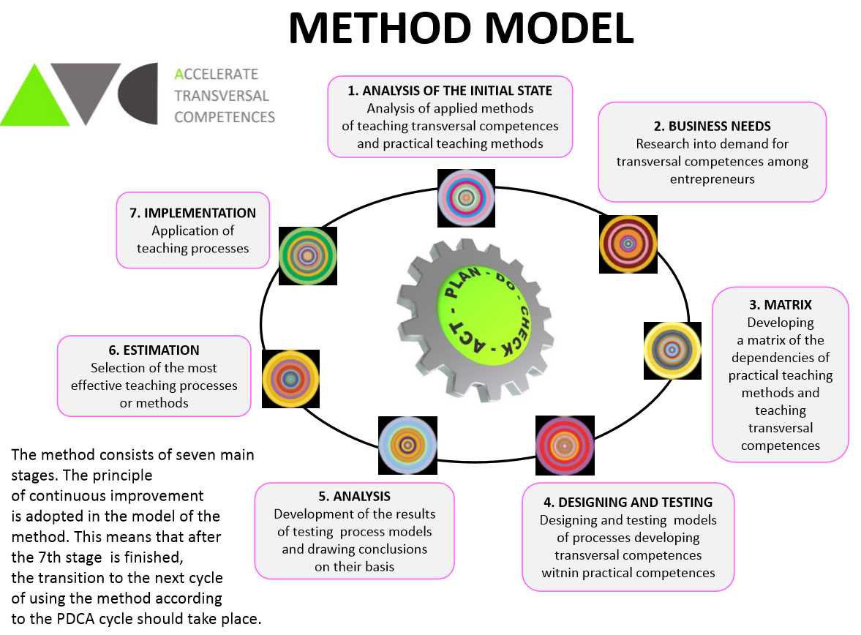

Slide 9
Process at Matej Bel University
Questionnaire appendix 2 - to measure the dynamics of changes in the evolution of acquired transversal competences (degree of change)
Questionnaire appendix 3 - for assessment of the evolution of transversal skills level of the students in practical teaching process (the level of possessed skills)

Slide 10
Information about testing at MBU
 | Method I (brainstorming) | Method II (teamwork) | Method III (Lecture delivered by eminent speaker)
Testing start day | 22. 02. 2017 | 08.03.2017 | 22.03.2017
Testing start time | 9:05 | 9:05 | 10:40
Testing end day | 1.03. 2017 | 22.3.2017 | 28.3.2017
Testing end time | 12:00 | 12:00 | 10:25
Duration of testing (min) | 320 | 320 | 160
Number of meetings with students | 2 | 2 | 2
Number of dean’s groups | 3 | 3 | 3
Number of test groups during a meeting | 3 | 3 | 3
Average size of test groups during a meeting | 11,5 (11 and 12) | 11,5 (11 and 12) | 11,5 (11 and 12)
Number of instructors | 2 | 2 | 2
Number of courses where methods were tested | 1 | 1 | 1
Type of activity | Demand in tourism market, Attractiveness’ of tourism destination | On-line communication of tourism destination Organizing events as a factor to overcome seasonality Analyzing visitor survey as a best practice example | Practical aspects of destination management at regional level Tax policy in tourism
Language of communication | Slovak
Nationality of testers | Slovak

Slide 11
The evolution of transversal skills level of the students in practical teaching process (the level of acquired skills)
 | Average result questionnaire 3 (average level of a skill prior to testing) | Average result questionnaire 3 (average level of a skill after testing) | Level of change
Entrepreneurship | 2.70 | 3.98 | 1,28
Creativity | 2.419 | 3.819 | 1,4
Teamwork | 3.10 | 4.33 | 1,23
Communicativeness | 2.99 | 4.18 | 1,19
Table shows difference between level of skills before implementation of practical teaching methods and after its implementation
The highest increase is visible in skill creativity and the lowest in communicativeness
Overall, there is significant increase in all transversal competences after implementation of practical teaching methods

Slide 12
Students’ assessment regarding the tested process as beneficial for their professional development
Assessment indicator | Numbers of students | Percentage of students
0 - no impact on the development | 0 | -
1 - beneficial in a very small extent | 0 | -
2 – beneficial in a small extent | 1 | 3%
3 - beneficial in a medium extent | 12 | 34.2%
4 - beneficial in a high extent | 18 | 51.4%
5 - beneficial in a very high extent | 4 | 11.4%
62.8% of students asses the tested process as a beneficial for their professional development in a high or very high extent
34.2% of students asses the tested process as a beneficial for their professional development in a medium extent
Only 3% of students asses the tested process as a beneficial in a small extent
None of students asses the tested process as a beneficial for their professional development in a very small extent or no impact

Slide 13
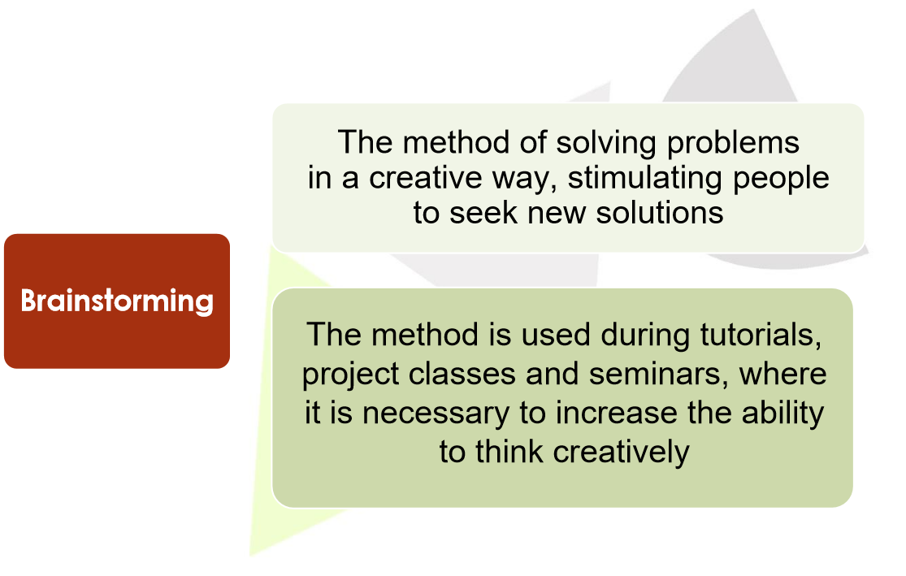

Slide 14
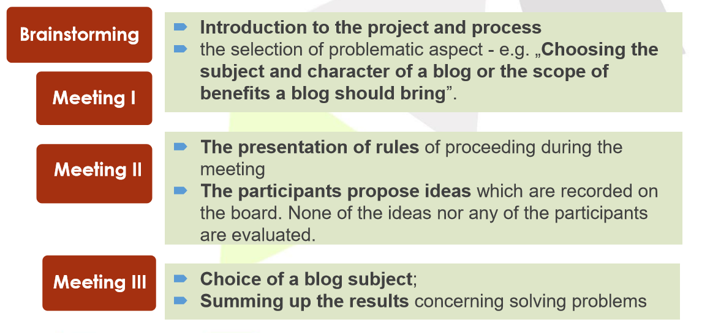
Scenario of using Brainstorming method

Slide 15
Experiences from MBU Slovakia
Each class or lecture, the group of students was divided into teams to ensure proper organization of testing work.
With each method, students worked in various teams. It was difficult to keep the same groups as not all the students attended the classes.
The students were divided into groups, with the size of 11 or 12 people in relation to their attendance of classes.
Sometimes it was visible the influence of “strong” personality in the group in a positive or negative manner and it might impact on the results of testing as well (by filling questionnaires).
Generally, students evaluated positively their participation in the testing process.
Students appreciated the variety of classes and exploitation of methods, that are not very common.
Several students appreciated the possibility to express own opinion and space for discussion, which is not created on all classes or seminars.
Several students suggested to incorporate this methodology into more subjects delivered at Matej Bel University.

